Slide 1
ORGANIZERS

Slide 2
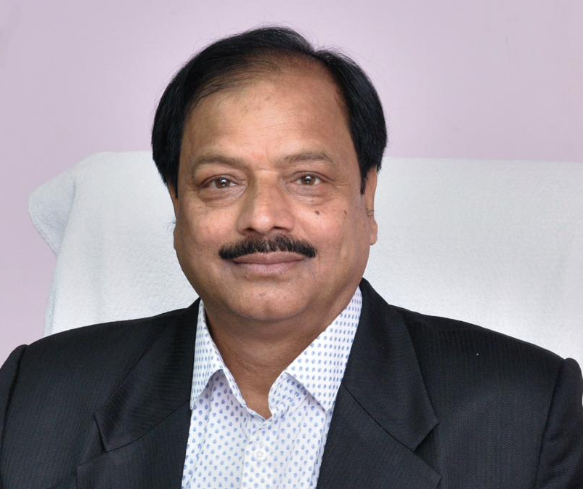
CHIEF PATRON :- SHRI M.M SINGH ( CHAIRMAN)

Slide 3
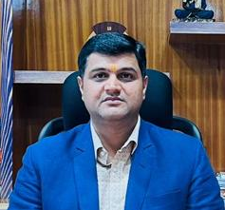
CHIEF PATRON :- SRI KRISHNA MURARI( MD)

Slide 4
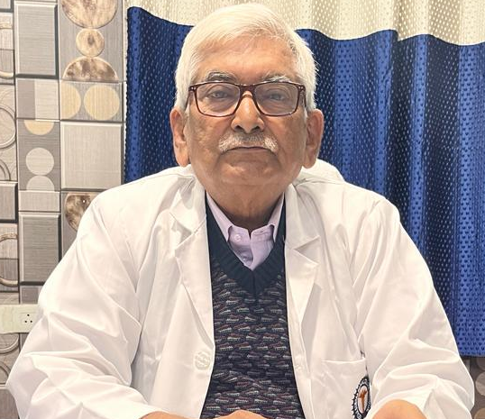
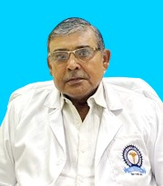
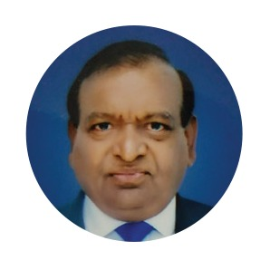
PATRONS :- 1. Dr. Ashok Sharan( PRINCIPAL) 2. Dr. Arvind prasad ( joint Director) 3. Dr. Ramji prasad ( joint Director)

Slide 5
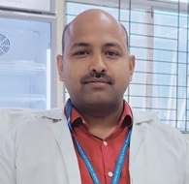
Organizing secretary :- Dr. Mukesh Kumar ( Prof& Head)

Slide 6
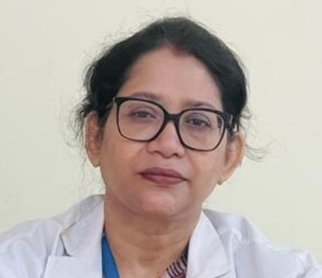
Joint organizing secretary:- Dr. Anupama Singh(assoc. prof)

Slide 7
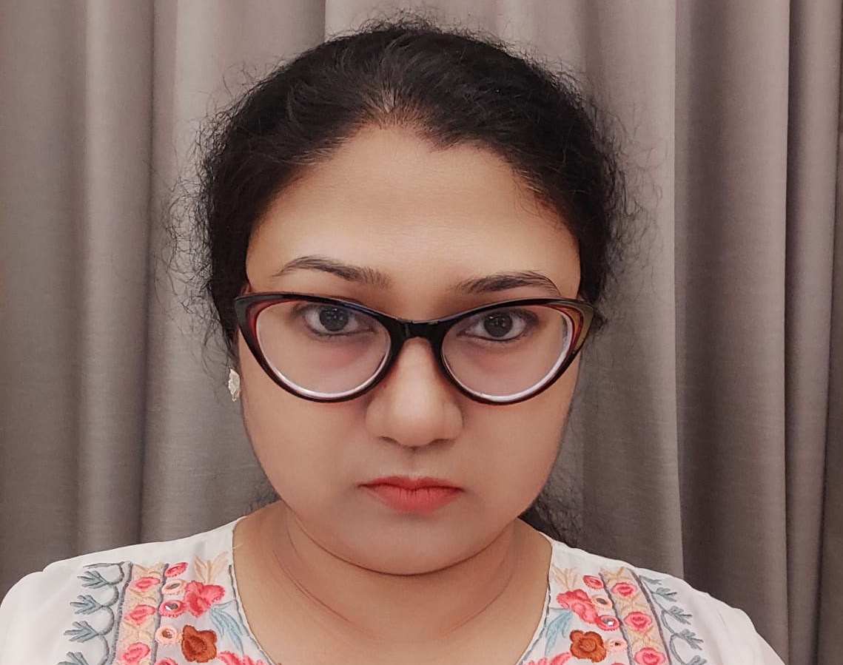
Treasurer:- Dr. Archana

Slide 8
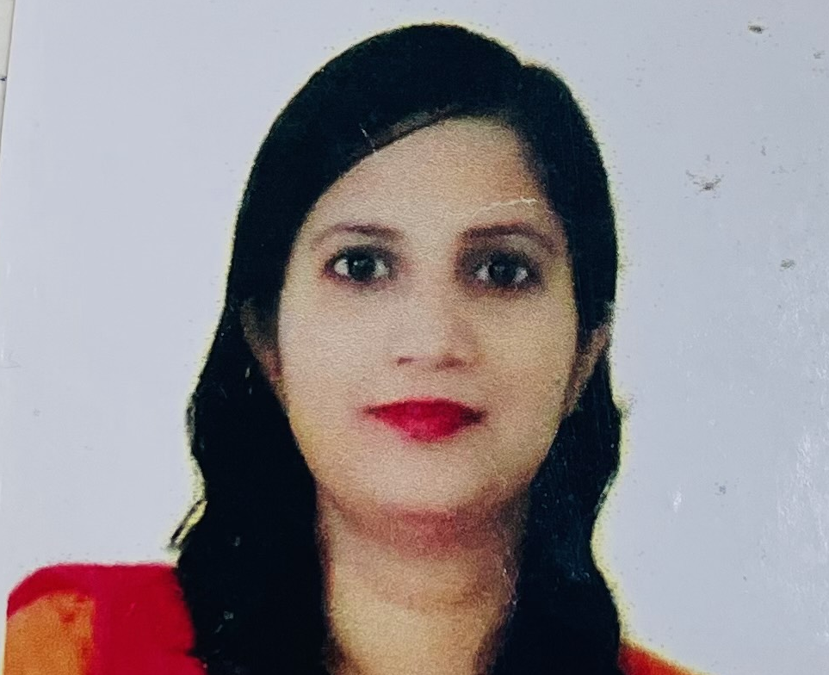
Convener Scientific committee:- Dr. Anubhuti(Assoc. prof)

Slide 9
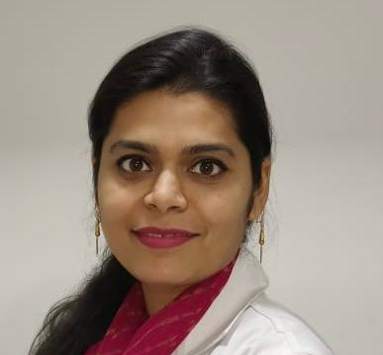
CONVENER SOUVENIR COMMITTEE:- Dr. Shafquat Jahan (Asst. prof)

Slide 10
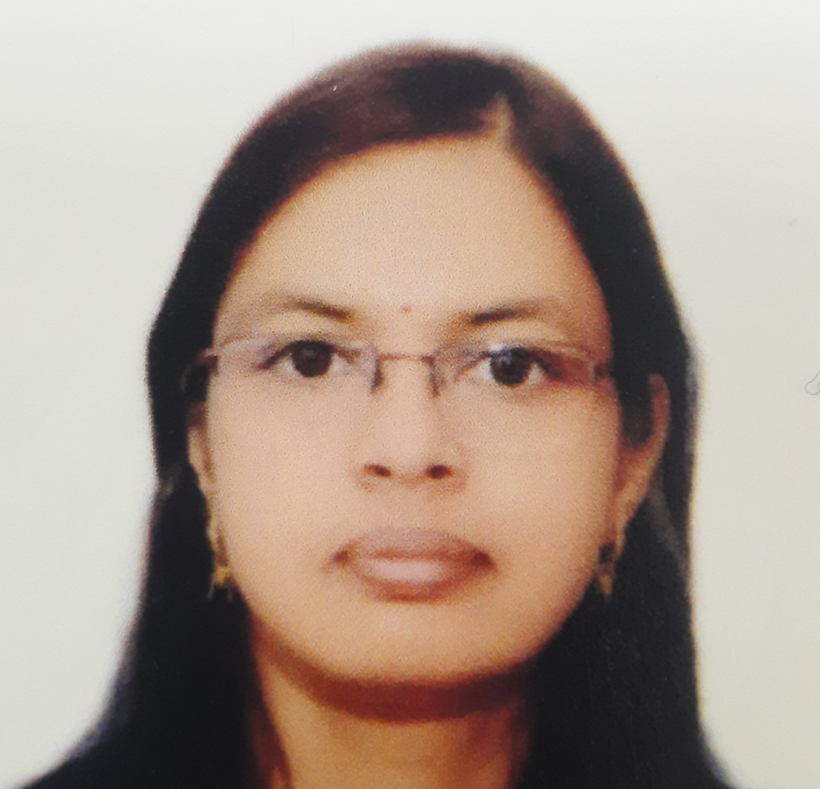
Convener registration committee:- Dr. Mridushri (Asst. prof)

